Slide 1
Numerical results for 1D chain

Slide 2
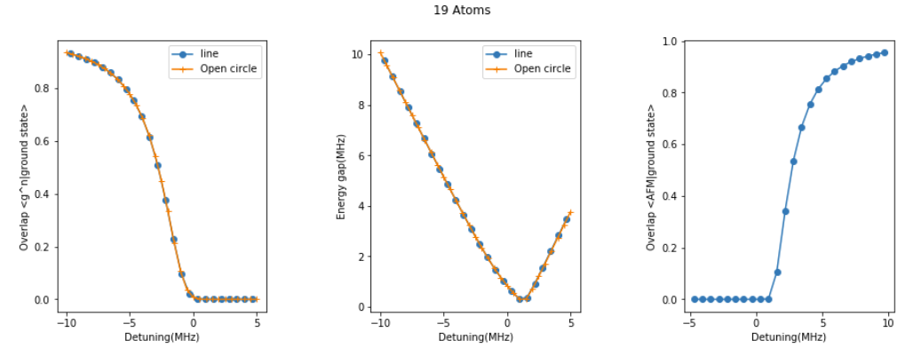
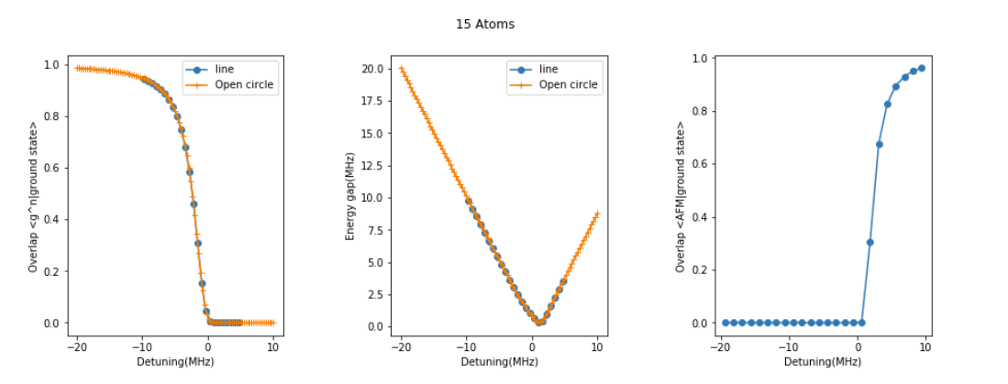
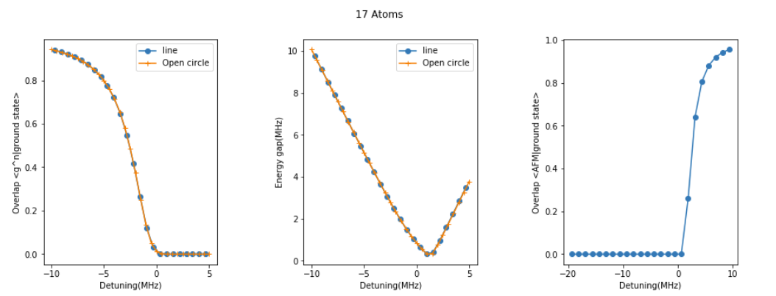
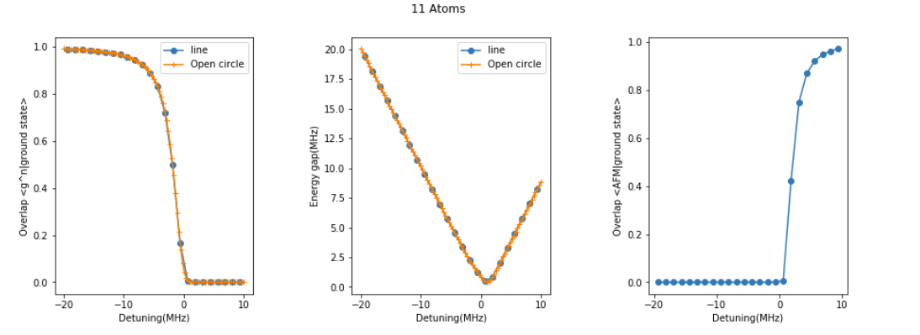
Energy gap(0)
The energy of the system with a 1D chain configuration(Yu’s results) is the same with an open chain configuration in the circle(Kenneth’s result) for different system sizes.

Slide 3
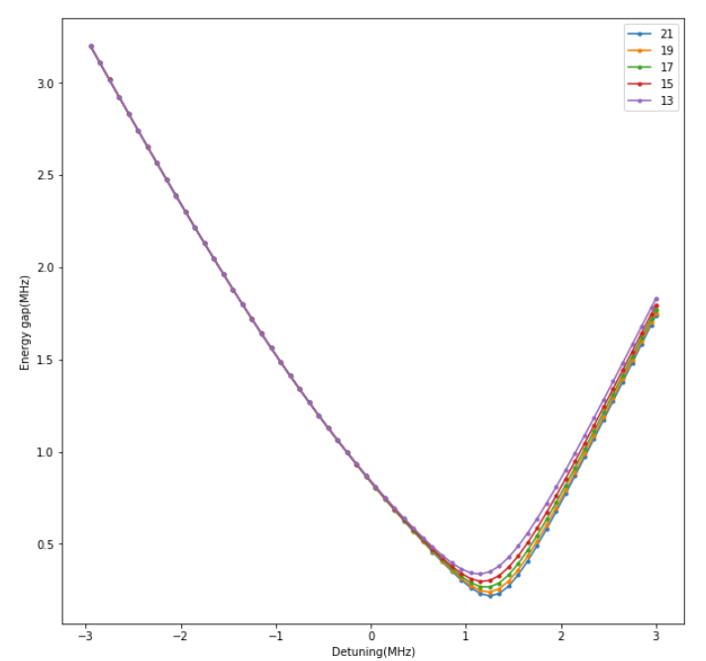
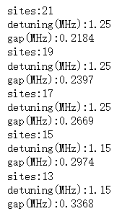
Energy gap(1)
With a finer scan, we find the critical point for different system size based on the criteria of minimizing the energy gap
gap scales like 1/L

Slide 4
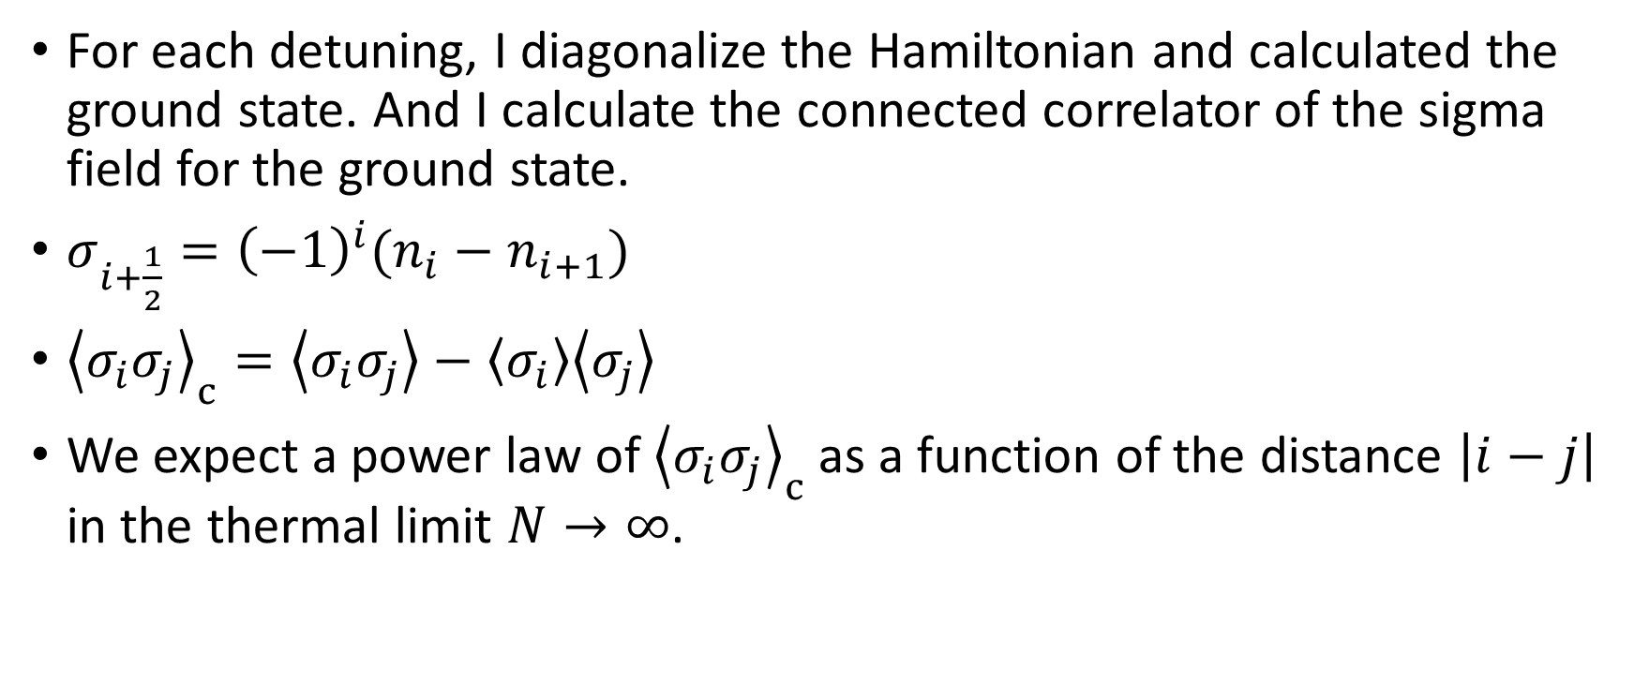
Eigenstate analysis(0)
For each detuning, I diagonalize the Hamiltonian and calculated the ground state. And I calculate the connected correlator of the sigma field for the ground state.
$σ_{i+\frac{1}{2}}={\left(−1\right)}^{i}(n_{i}−n_{i+1})$
${\left\langle σ_{i}σ_{j}\right\rangle }_{c}=\left\langle σ_{i}σ_{j}\right\rangle −\left\langle σ_{i}\right\rangle \left\langle σ_{j}\right\rangle$
We expect a power law of ${\left\langle σ_{i}σ_{j}\right\rangle }_{c}$ as a function of the distance $\left|i−j\right|$ in the thermal limit $N→∞$.

Slide 5
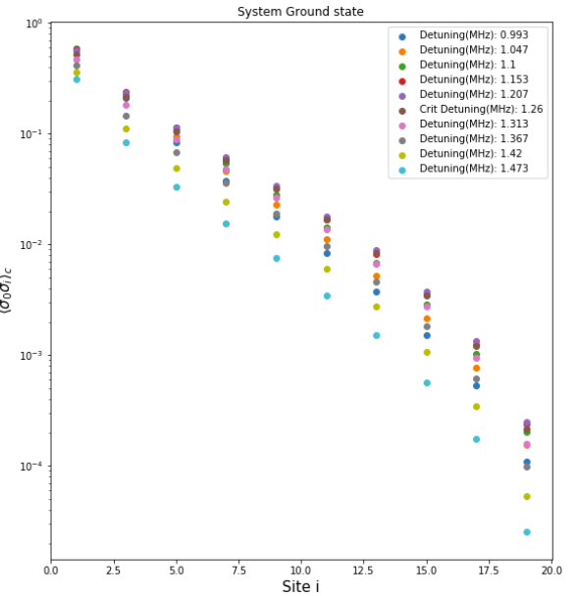
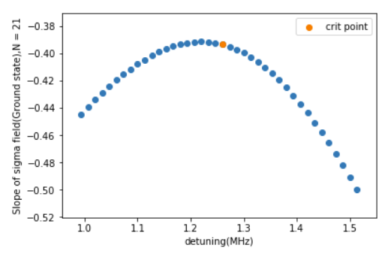
Eigenstate analysis(1): The ground state of the 21 sites 1D chain

Slide 6
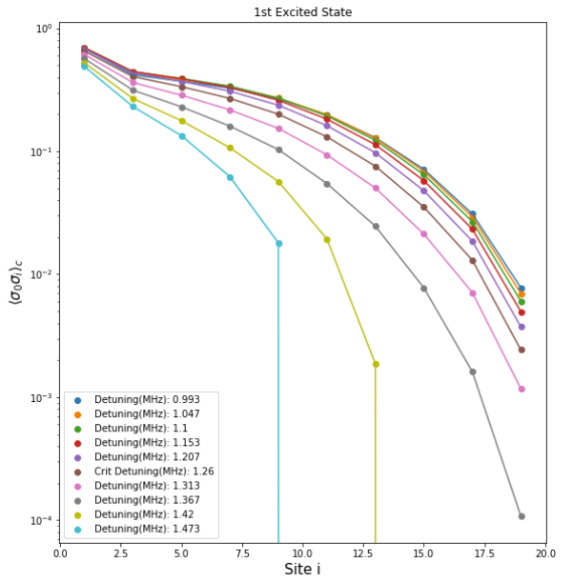
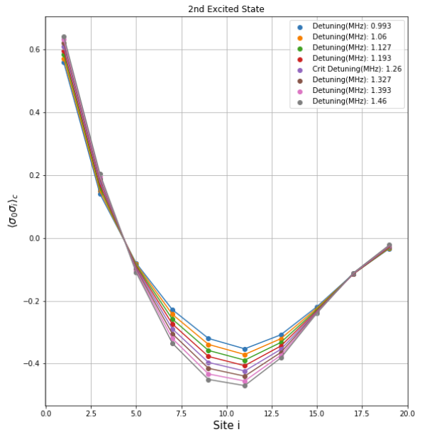
Eigenstate analysis(1): The chain1st and 2nd excited state of the 21 sites 1D chain
The ground state of the system follows the power law while the excited states have very different behavior.
We want to maximize the overlap of our evolved state with the ground state to see the power law.

Slide 7
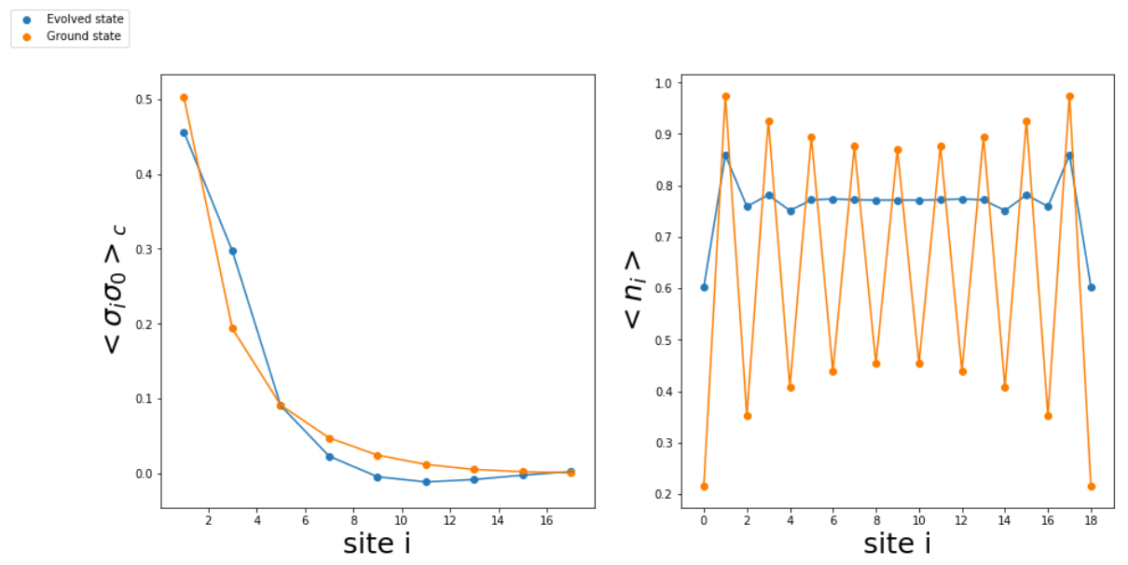
DiLILA dynamics analysis(0)
Here is a typical result with a Dilila ramp(T=16us, Rabi= 2.4MHz) . It seems at the critical point the evolved state does not agree with the power law very well, which means the system is not at the ground state during the ramp.
We want to tune the ramp parameters to optimize the overlap with the ground state.
Notes:
L,19,1dt,0.0512hole_den,0.No,0T,16.Omega,1.2dinit,-10.gapinit,10.gapcrit,0.24gapfin,4.8dcrit,1.2dfin,6.tinflect,10.5

Slide 8
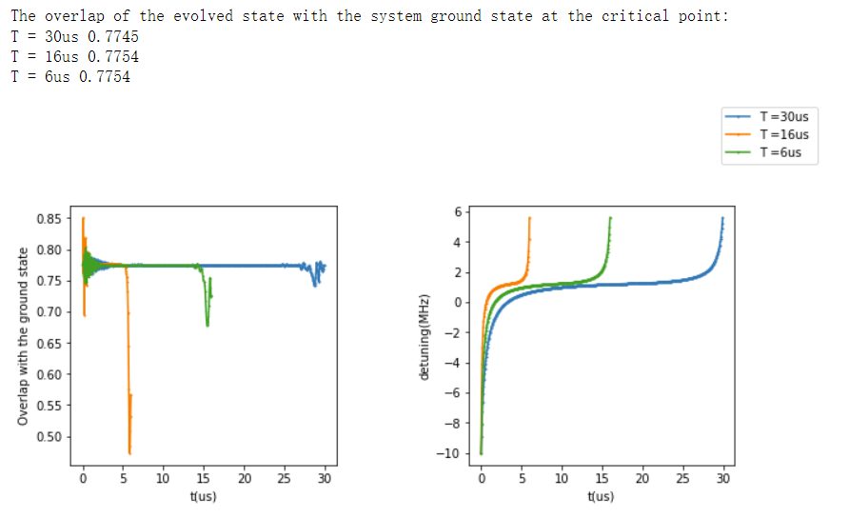
DiLILA dynamics analysis(1)
Fix the initial and final detuning
Vary the length of the Dilila ramp
(Rabi = 2.4MHZ(corrected by Avery) )
Though the length of the Dilila ramp extends significantly from 6us to 30us, the initial overlap does NOT improve.
Conclusion: the limiting factor of the overlap is NOT the adiabaticity close to the critical point (if we ignore the decoherence effect).
Simulated with 19 sites

Slide 9
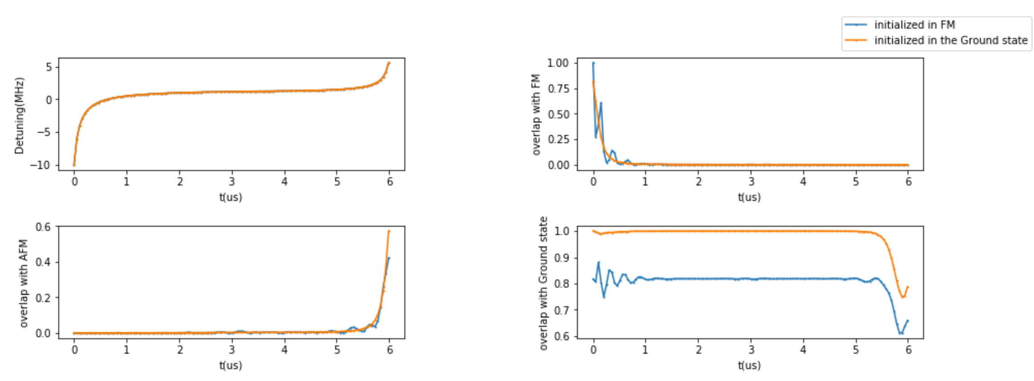
DiLILA dynamics analysis(2)
Simulated with 15 sites
A further proof of this conclusion:
Starting from the real ground state will result in a better overlap at the critical point and final AFM state preparation with the same ramp compared to starting form the FM state.

Slide 10
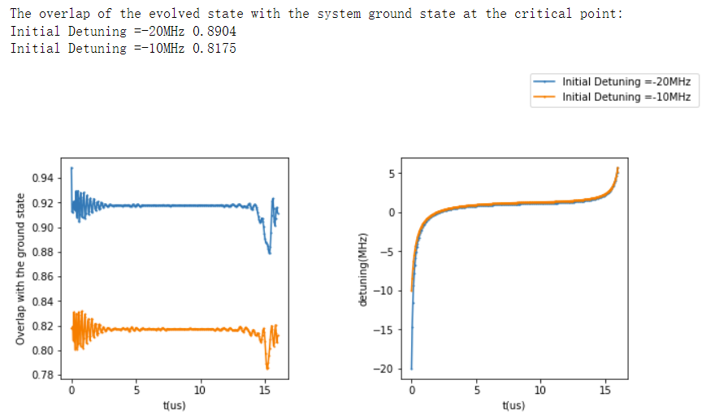
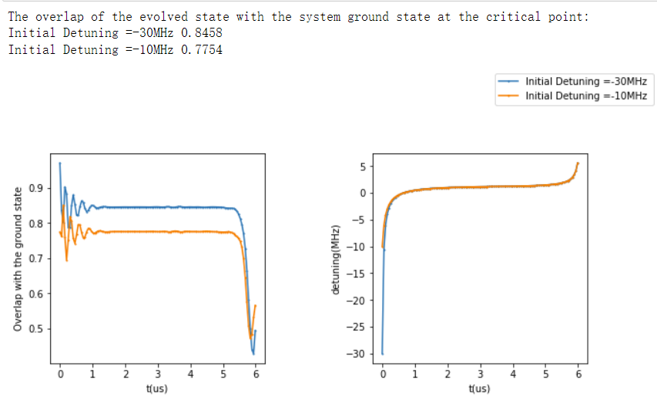
DiLILA dynamics analysis(3)
Simulated with 15 sites
Simulated with 19 sites
The main issue here is the initial overlap, suggesting we are not deep enough in the disordered phase.
Dilila ramps with different initial detuning proves that large initial detuning helps the initial overlap, which will be mostly kept after the LILA ramp.
However, a large initial detuning is not realistic in experiment since a minimum initial detuning given a certain initial overlap grows as the system size. For example, to increase the initial overlap by 8% for 15 sites we need to go from -10MHZ to -20MHz, while for 19sites, we need to go from -10MHz to -30MHz.

Slide 11
DiLILA dynamics analysis(3)
The overlap between our evolved state and the ground state is not large enough so that one cannot see the expected power law.
The main issue here is the initial overlap.
Total length of the DILILA Ramp does not help to improve the initial overlap.
Increasing the initial detuning helps but the it works less efficiently in larger system.
Is there another way to boost up the initial overlap?

Slide 12
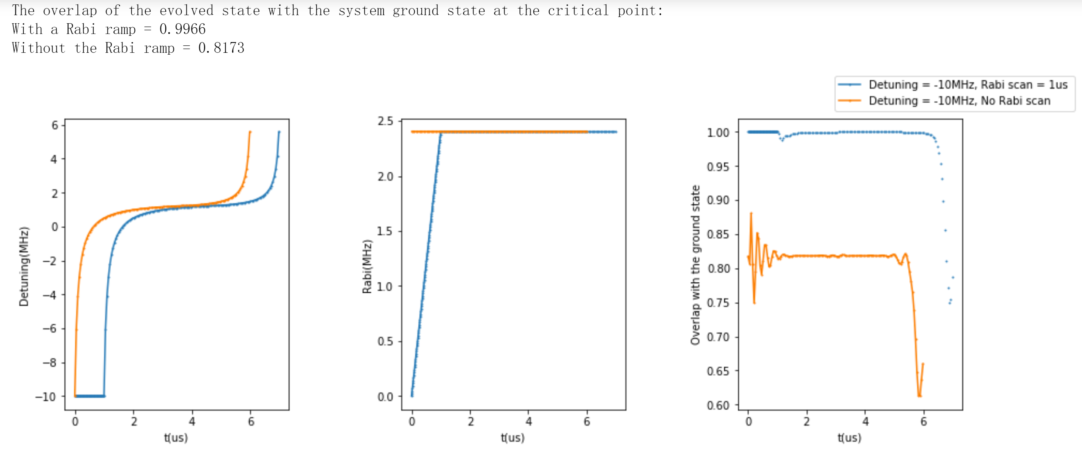
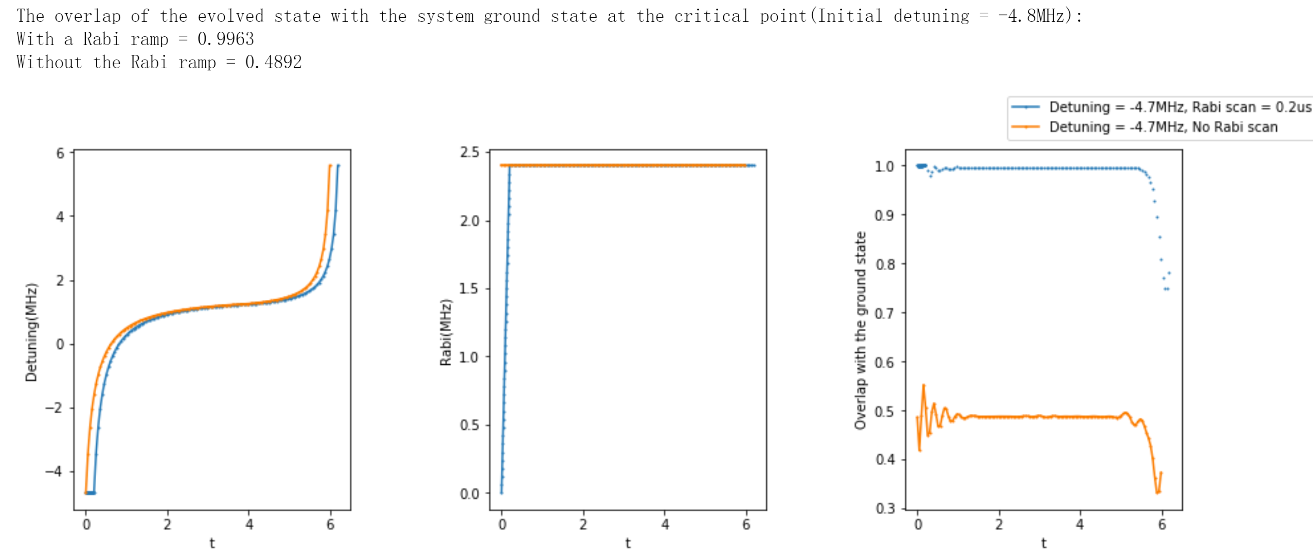
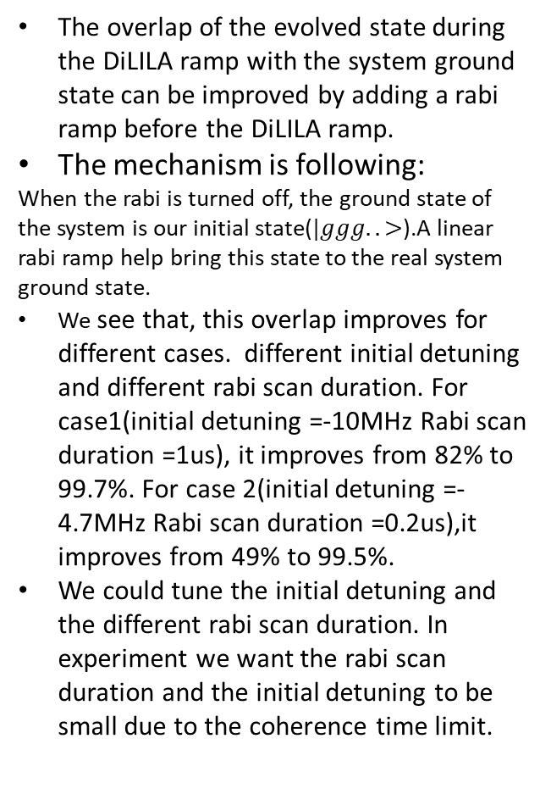
Rabi Scan（0）
The overlap of the evolved state during the DiLILA ramp with the system ground state can be improved by adding a rabi ramp before the DiLILA ramp.
The mechanism is following:
When the rabi is turned off, the ground state of the system is our initial state($|ggg..>$).A linear rabi ramp help bring this state to the real system ground state.
We see that, this overlap improves for different cases. different initial detuning and different rabi scan duration. For case1(initial detuning =-10MHz Rabi scan duration =1us), it improves from 82% to 99.7%. For case 2(initial detuning =-4.7MHz Rabi scan duration =0.2us),it improves from 49% to 99.5%.
We could tune the initial detuning and the different rabi scan duration. In experiment we want the rabi scan duration and the initial detuning to be small due to the coherence time limit.

Slide 13
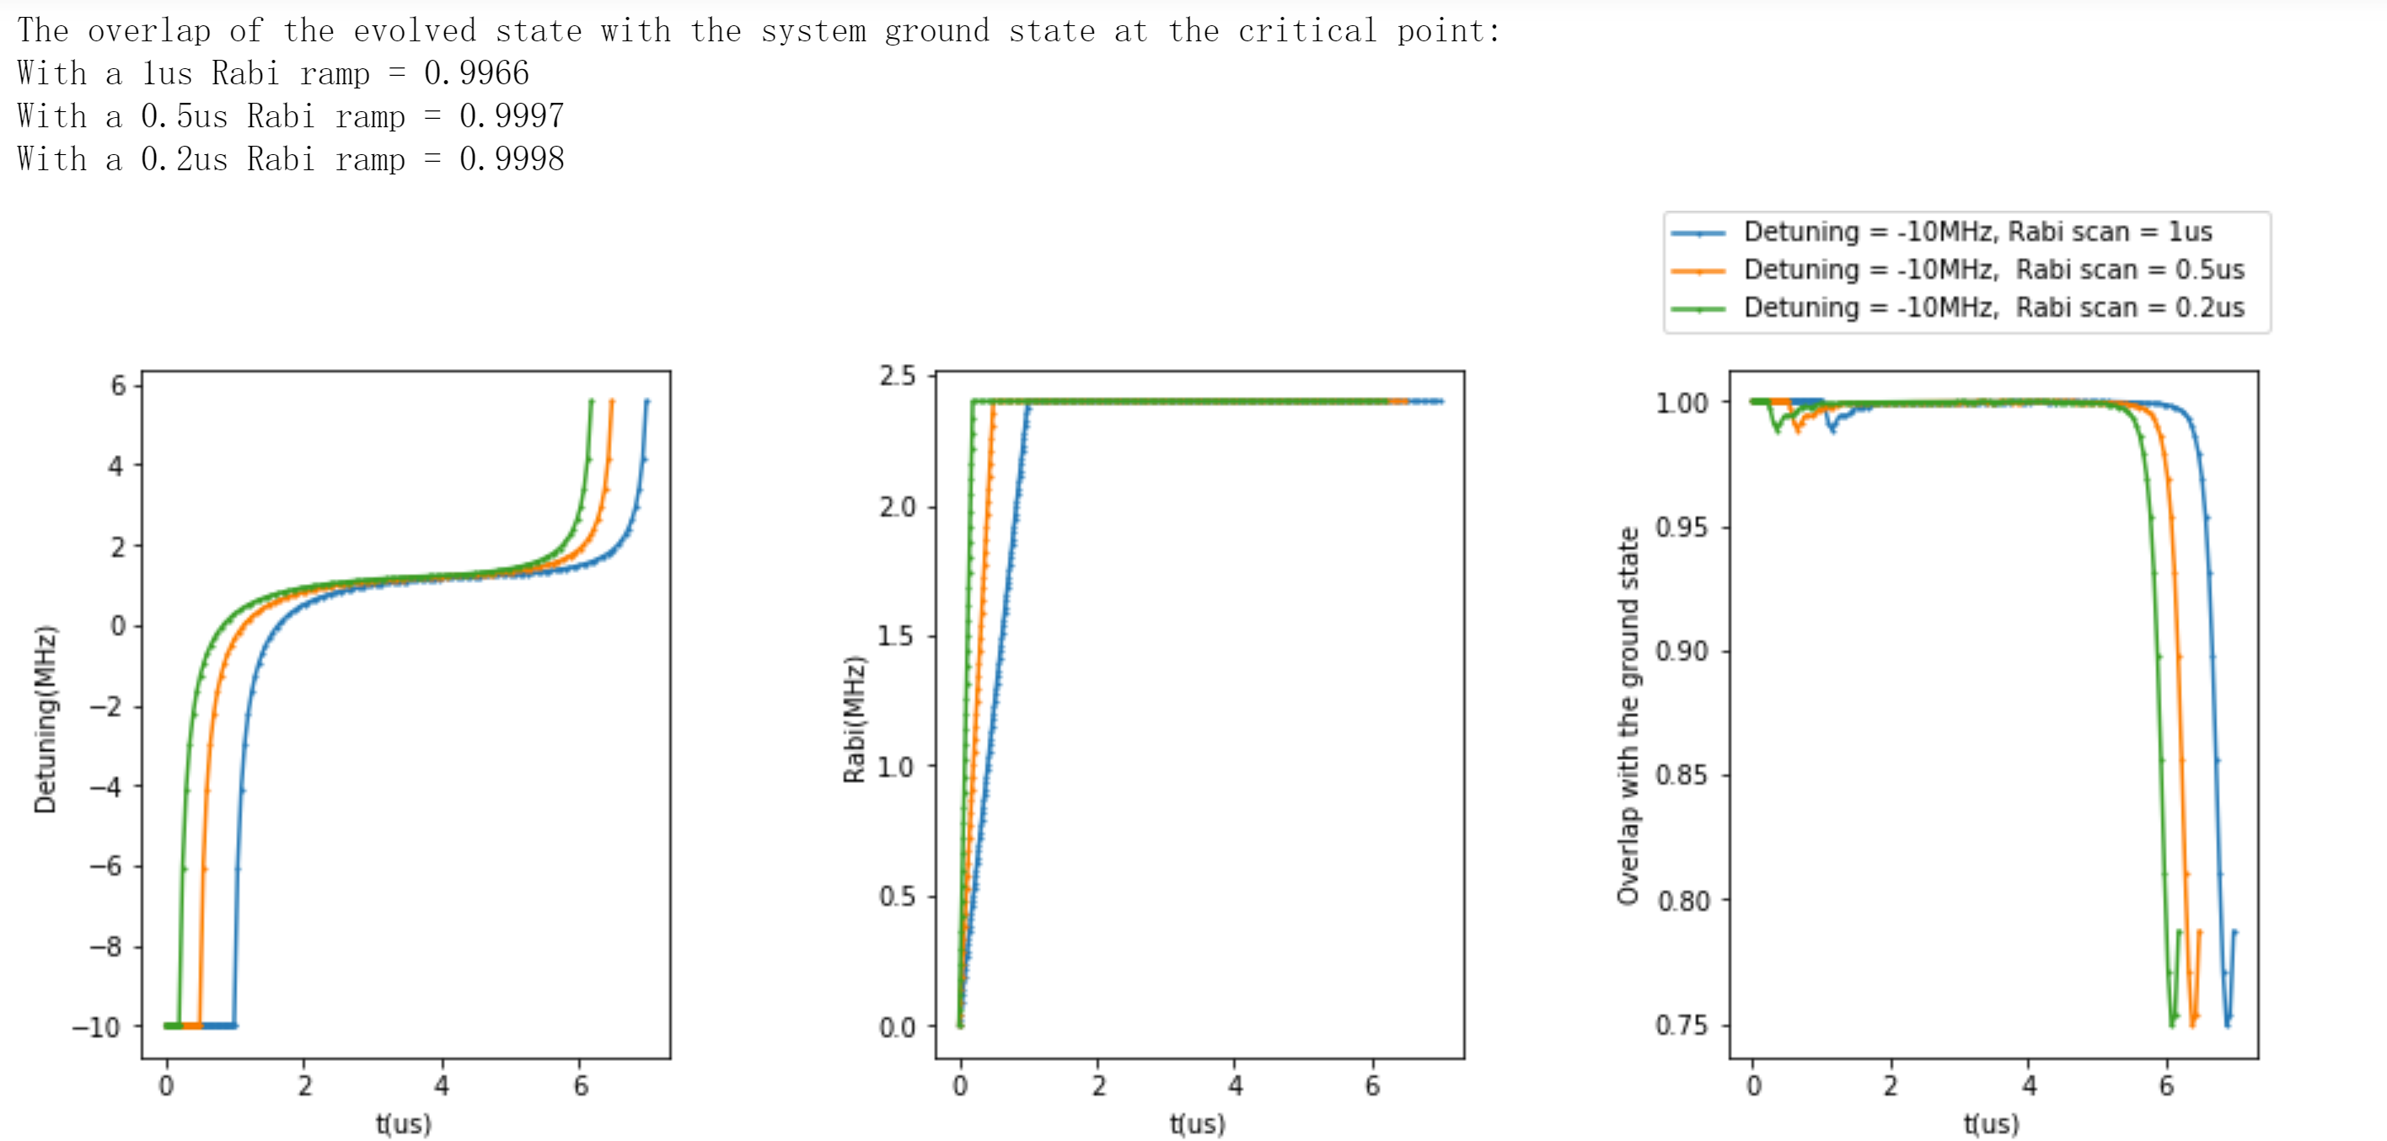
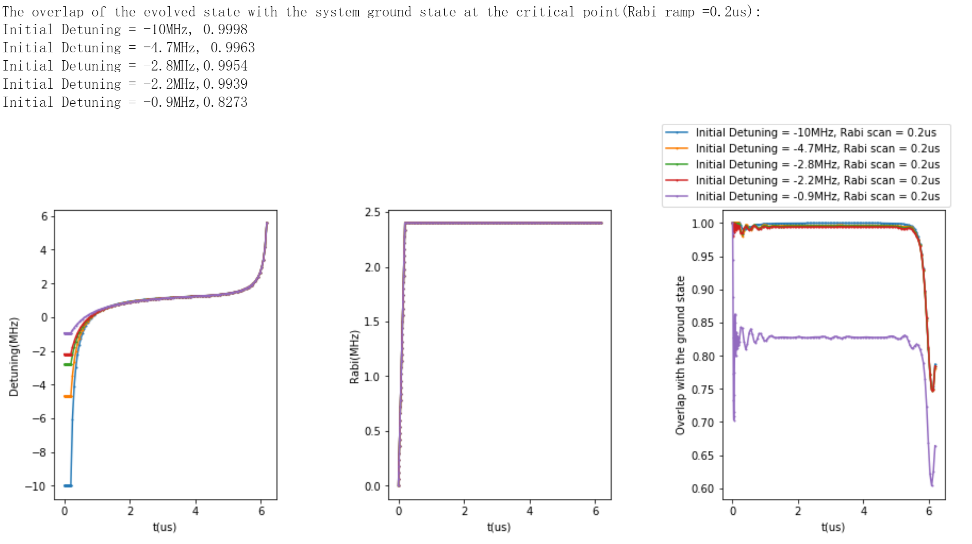
Rabi Scan（1）
Here we tune those two parameters:
For a given initial detuning, we sweep the duration of the rabi scan and we see that even the rabi ramp is very short(0.2us), it still keeps the improvement of the overlapping comparing to no sweep.
We keep the rabi scan to be 0.2 us and sweep the initial detuning. Intuitively we would expect the small initial detuning(absolute value) will result in a poor overlap. According to the simulation, this effect is visible only when the initial detuning is greater than -2.2MHz.
So we prove that a rabi scan is much more effective than the starting from deep in the disordered phase. For comparison:
 | Initial detuning | Overlap
No Rabi ramp | -10MHz | 82%
No Rabi ramp | -4.7MHz | 49%
0.2us Rabi ramp | -10MHz | 99.98%
0.2us Rabi ramp | -4.7MHz | 99.6%

Slide 14
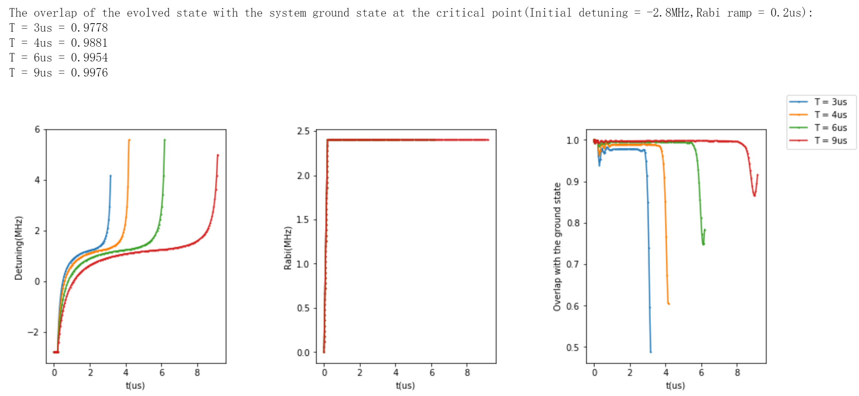
Rabi Scan（2）
Since we proved that the rabi scan greatly improve the initial overlap, we try to reduce the total length of the dilila ramp with a initial rabi scan.
Here we show that the longer the scan is, the overlap is better(due to the improvement of the adiabaticity ).
However, though we are limited by coherence time, since the initial overlap is already improved, the system still has a very large overlap with the ground state at the critical point.
(Here I vary the total duration T of the dilila ramp and keep the time to reach the critical point at 2/3 T)

Slide 15
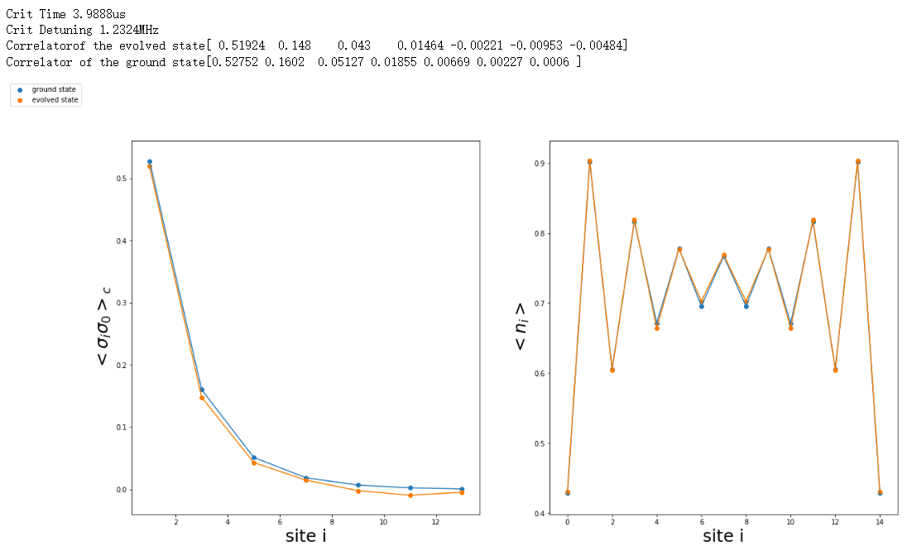
Experimental scheme
If we have a coherence time of 10~15us
We could set the experimental pulse like following:
A rabi ramp from 0 to 1.2MHz in 0.2us
A UniLILA ramp from -2.8MHz to critical point in 4us (corresponding to a 6us DILILA ramp).
We expect the system has a 99.5% overlap with the system ground state(follows the power law)
The limitation here is the system size.

Slide 16
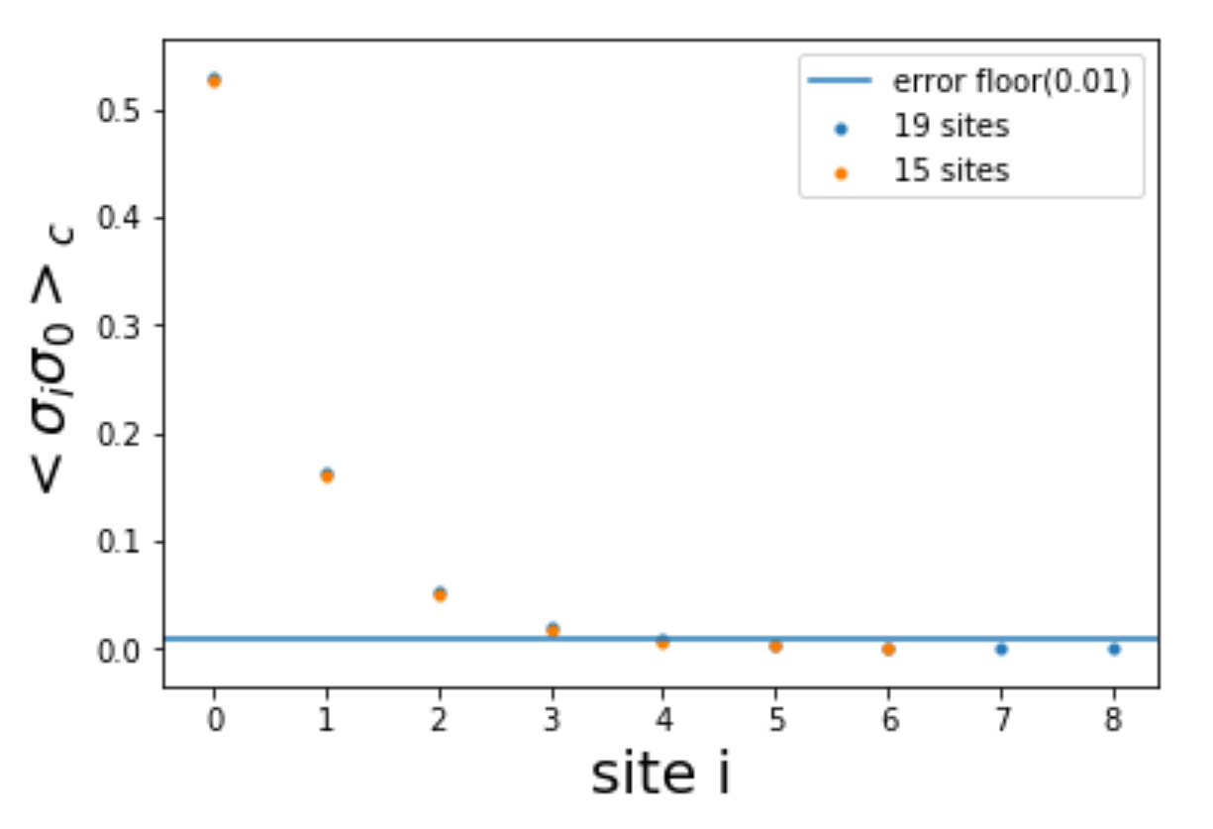
Back up 1

